Slide 1

Internship on AWS CLOUDCOMPUTING Project : LEARNING MANAGEMENT SYSTEM
Department of Computer Science & Engineering
2024-25
Batch Number:
Under the guidance of,
Sharmila G K,
Assistant Professor,
Department of CSE,
RYMEC
by,
3VC21CS078: K.V.GOWTHAM

Slide 2
AGENDA
Introduction of Company
Tasks Performed
problem Statement
Objective
Benefits to the Organization
Implementation
Results
References

Slide 3



INTRODUCTION OF COMPANY
Rooman Technologies in Partnership with N.S.D.C offered a 1 months Project Based Experiential Internship where we got an opportunity to explore, understand various emerging technologies related to AWS CLOUD COMPUTING and apply the relevant skills to solve real world problems.
We also got an opportunity to Develope & Manage E-Learning Management System (ELMS)
where we worked in teams to solve challenges.
Rooman Technologies - Provides IT training, upskilling, and certification programs, Partners with government initiatives (PMKVY, NSDC) for skill development

Slide 4
TASKS PERFORMED
Developed User Authentication Module for E-Learning Management System (ELMS).
Designed and configured Dashboard Interface with role-based dynamic content.
Integrated Keka HR software with IoT-enabled biometric attendance systems.
Managed employee attendance & payroll system with real-time data sync.
Assisted in Smart City ITMS project (Shivamogga) – IoT sensors & ANPR cameras.
Performed Network Scanning & Vulnerability Assessment using Nmap & OpenVAS.
Engaged in software development, testing, troubleshooting, and documentation.
Enhanced problem-solving, communication, and project management skills

Slide 5
AREA & PROBLEM STATEMENT
Increasing integration of digital technologies in daily business operations.
Growing exposure to sophisticated cyber threats targeting sensitive data.
Challenges in real-time implementation and management of security measures.
Gap between available security technologies and effective utilization.
Organizations require automated, integrated solutions for managing:
User authentication & access control.
Employee data & Attendance system
Smart city infrastructure & public safety networks

Slide 6
OBJECTIVES
Gain hands-on technical expertise in industry-relevant technologies.
Improve communication, teamwork, and time management through collaboration.
Evaluate career interests and aptitudes in software development and IT solutions.
Build professional networks by interacting with mentors and industry experts
Apply theoretical knowledge to real-world projects and case studies

Slide 7
Benefits to Organization
Contributed to development and enhancement of key IT systems (ELMS, HR management).
Assisted in streamlining employee attendance and payroll processes with Keka HR integration.
Supported deployment and monitoring of Smart City solutions (ITMS, e-Challan systems).
Reduced workload for full-time staff by supporting daily IT operations.
Assisted in documentation, system testing, and troubleshooting of enterprise solutions.
Aided in data analysis and reporting, enhancing decision-making processes.

Slide 8
Implementation
User Authentication
Dashboard Interface
Keka HR system
Developed and deployed User Authentication Module for secure access to ELMS.
Configured Keka HR System integrated with biometric and IOT devices for attendance tracking.
Designed and implemented Dashboard Interface with real-time updates and analytics.
Leave Management
Smart City solutions
Network scanning
Integrated leave management and payroll systems with cloud-based HR software.
Assisted in deployment of Smart City solutions (Intelligent Traffic Management System & e-Challan modules)
Conducted network scanning and vulnerability assessments to enhance cybersecurity

Slide 9
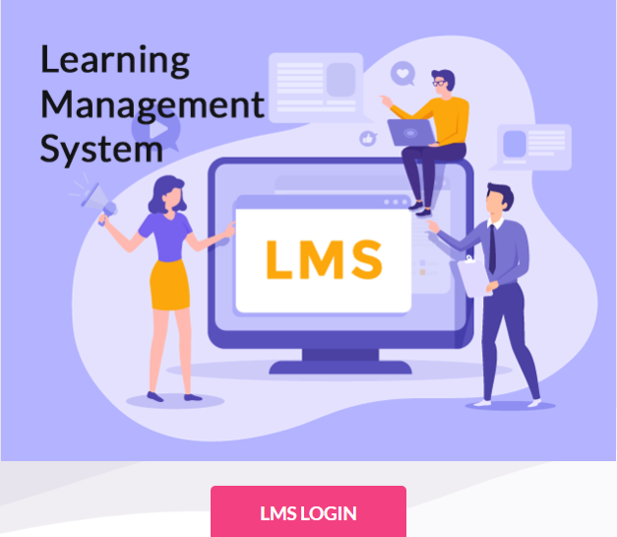
RESULTS
Successfully developed and deployed the Learning Management System (LMS).
Implemented secure User Authentication Module and dynamic Dashboard Interface.
Enabled easy LMS access and login for students, trainers, and administrators.
Improved course management, tracking, and reporting through the LMS platform.
Increased user engagement with intuitive and user-friendly interfaces

Slide 10
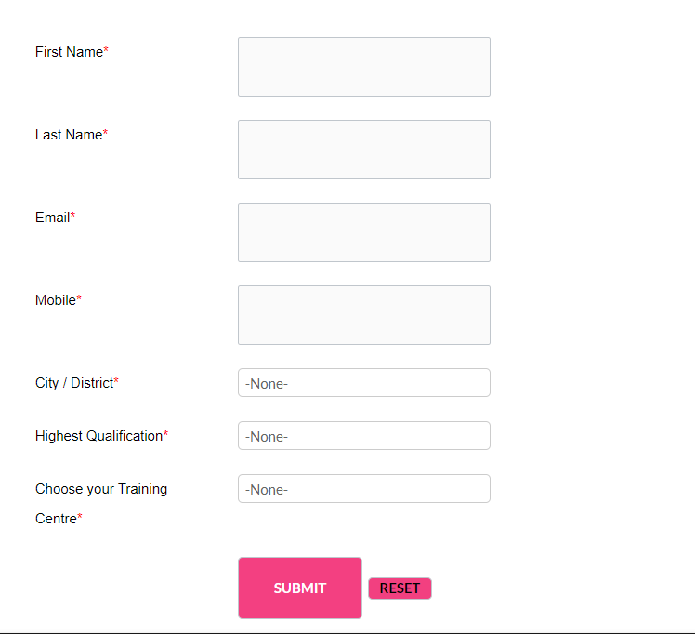
RESULTS
Designed an intuitive user registration form for easy enrollment.
Captures essential user details: Name, Email, Mobile, City/District.
Includes dropdown menus for selecting qualification and training center.
Ensures data validation with mandatory (*) fields for accurate submissions.
Integrated Submit And Reset buttons for smooth user interaction.

Slide 11
REFERENCES
https://rooman.net
https://www.keka.com/attendance-management-system
https://www.tummoc.com
https://in.search.yahoo.com/search?fr=mcafee&type=E211IN826G0&p=traffic+management+system
https://e-student.org/what-is-e-learning
https://www.businessinsider.com/guides/learning/online-learning-platform-comparison?IR=T#the-best-online-learning-platforms-for-creative-skills-and-hobbies-10

Slide 12

THANK YOU

